Slide 1

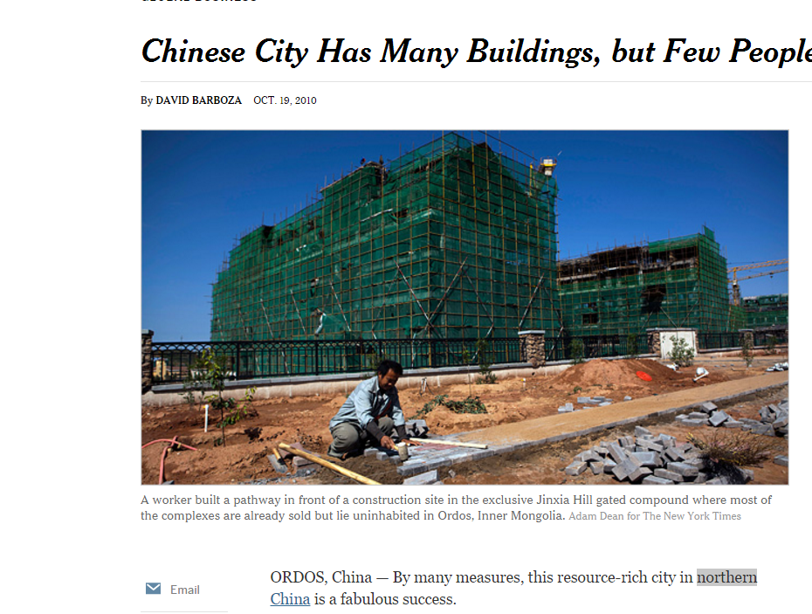
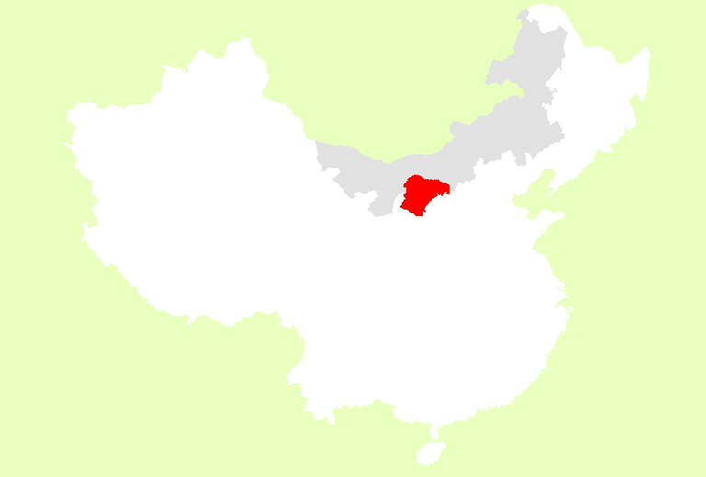

Factors affect the Population distribution in Ordos city, Inner Mongolia, P.R China
Inner Mongolia Province
Ordos City

Slide 2
Data Collection & Processing
DMSP/OLS From NOAA
Statistics Year Book in County Level (Publish as Paper based)
Population, Grass Land area, Gross Regional Product GRP
Returning Farmland Forest Program

Slide 3
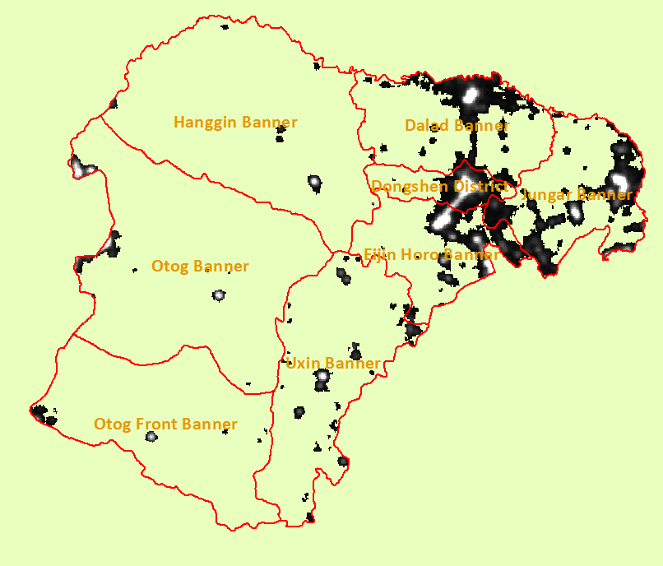
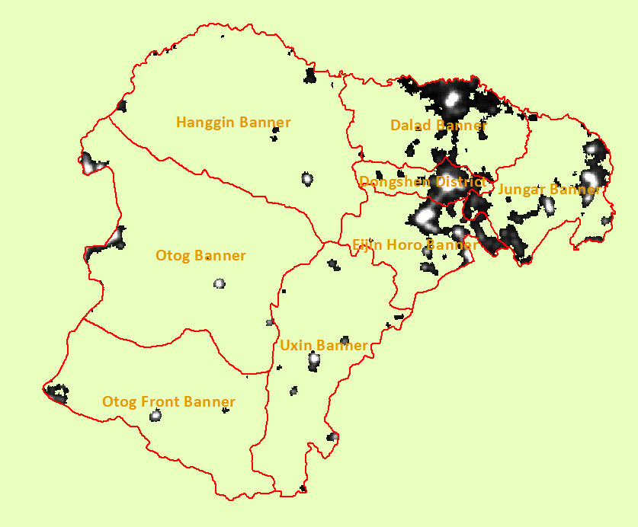
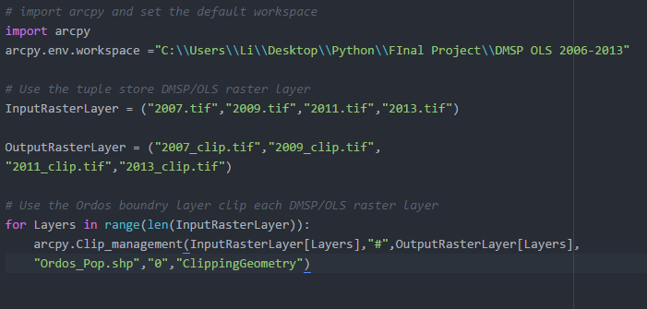

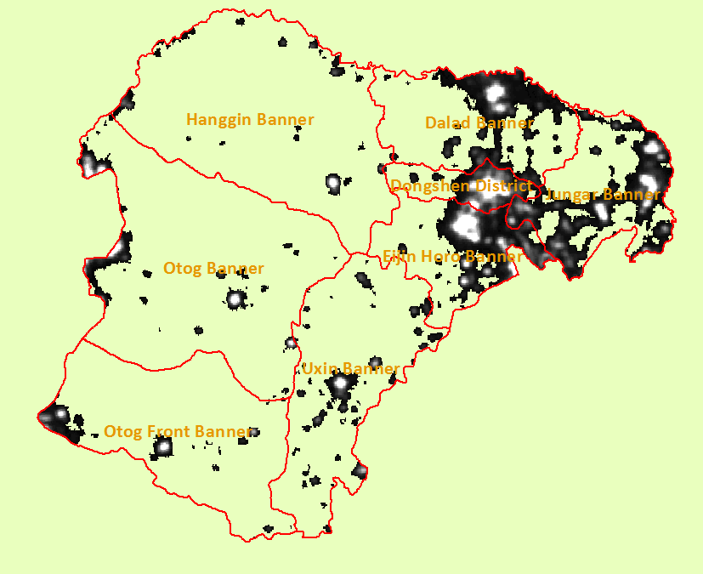
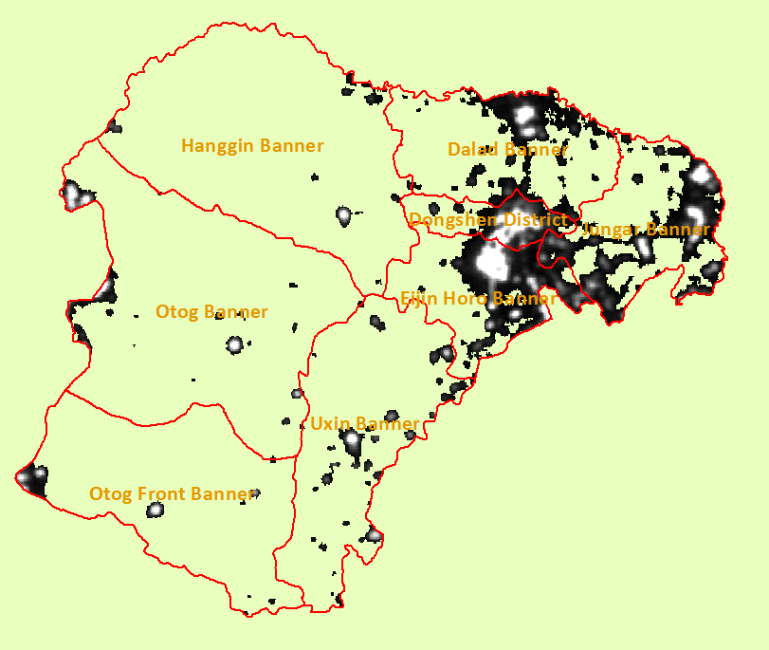
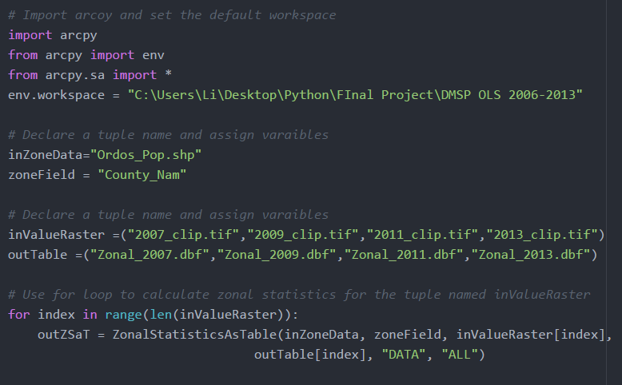
Raster Clip
2007
2009
Zonal Statistics
2011
2013

Slide 4
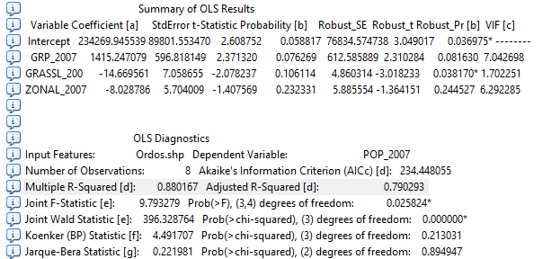
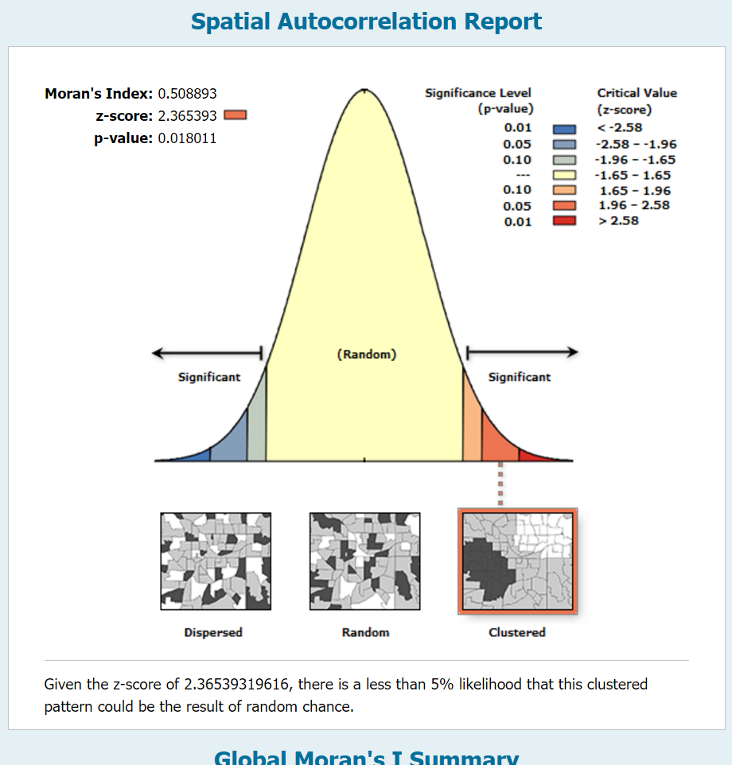
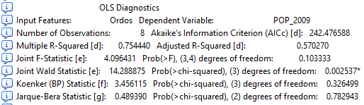
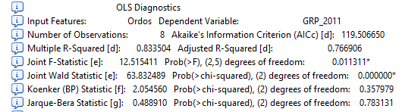
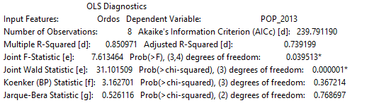
2007 OLS
Spatial Autocorrelation(Moran’s I)
2009 OLS
2011 OLS
2013 OLS

Slide 5
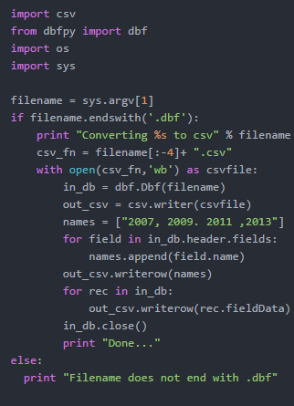
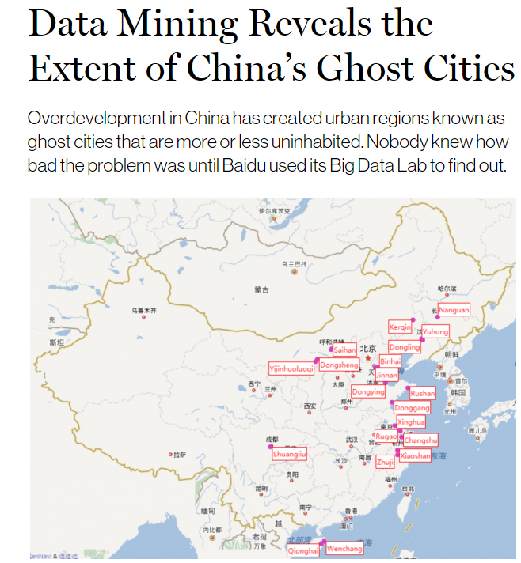
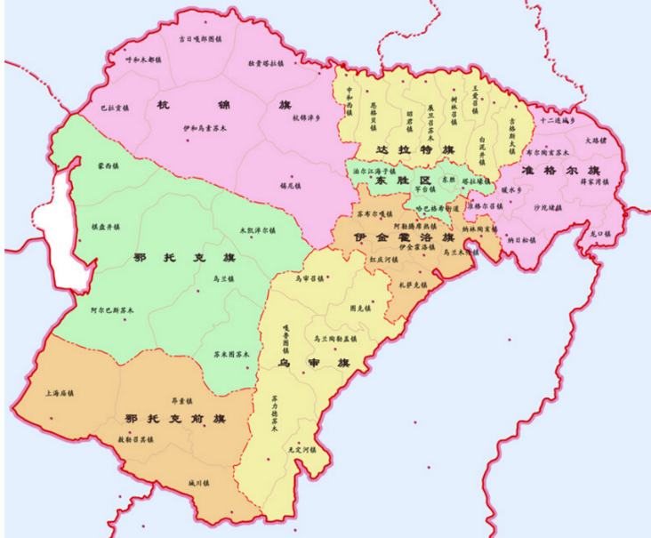
Convert Dbf to CSV
Future Work
Landsat 8
Extract Urban pixel and Calculate NDVI
Collect Statistics in town Level
WEIBO POI DATA
Visualized Population distribution in Ordos

